Slide 1
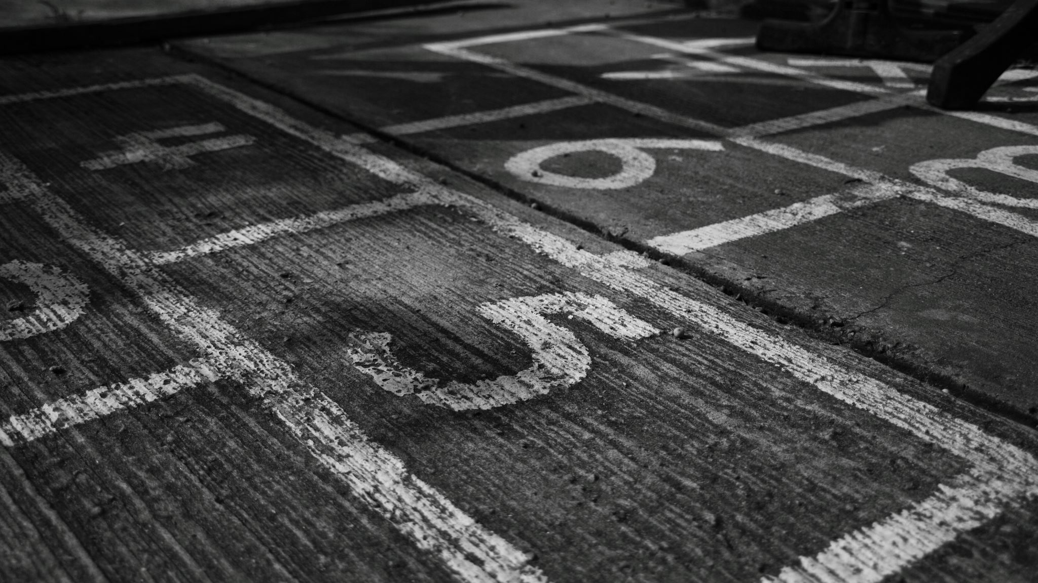
Lane Detection
BY SRINIVASAN E V 212221060261
ROHAN T 2122210228
KISHORE KUMAR R 212221060128
ECE Dept.

Slide 2
Abstract
Lane Line detection is a critical component for self driving cars and also for computer vision in general. This concept is used to describe the path for self-driving cars and to avoid the risk of getting in another lane.
In this article, we will build a machine learning project to detect lane lines in real-time. We will do this using the concepts of computer vision using OpenCV library. To detect the lane we have to detect the white markings on both sides on the lane.
Using computer vision techniques in Python, we will identify road lane lines in which autonomous cars must run. This will be a critical part of autonomous cars, as the self-driving cars should not cross it’s lane and should not go in opposite lane to avoid accidents.

Slide 3
Introduction
The traffic safety becomes more and more convincing with the increasing urban traffic. Exiting the lane without following proper rules is the root cause of most of the accidents on the avenues. Most of these are result of the interrupted and lethargic attitude of the driver. Lane discipline is crucial to road safety for drivers and pedestrians alike.
The system has an objective to identify the lane marks. It’s intent is to obtain a secure environment and improved traffic surroundings. The functions of the proposed system can range from displaying road line positions to the driving person on any exterior display, to more convoluted applications like detecting switching of the lanes in the near future so that one can prevent concussions caused on the highways.

Slide 4
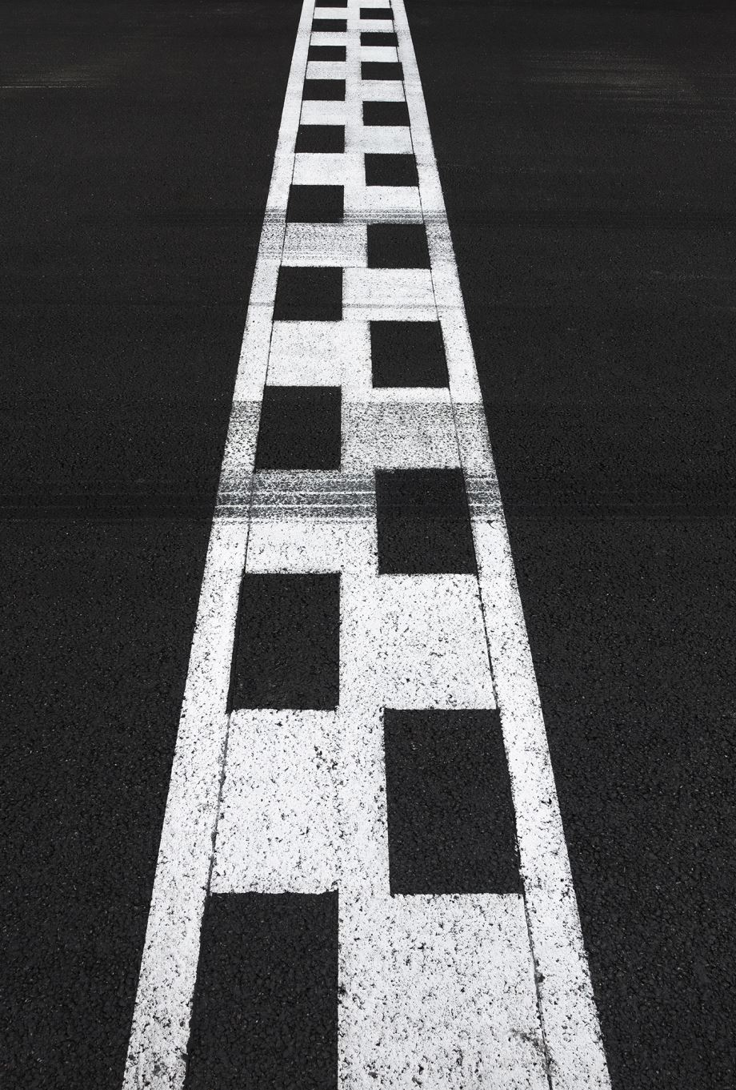
Objective
Safety is the main objective of all the road lane detection systems due to the reason is that most of the vehicle road accident happens because of the driver miss leading of the vehicle path. Therefore, currently many different vision-based road detection algorithms have been developed to avoid vehicle crash on the road.

Slide 5
Existing System
Nowadays various lane detection algorithms have been used for assisting the driver in Advanced Driver Assistance System(ADAS). Majority of these techniques have focused on the detection of straight lanes and curved lanes have been ignored.Thus the gaps which exist in the literature are:
Majority of work is based on straight lane images i.e. curved lane images have been ignored
The improvement in Hough Transform has been ignored for better Lane Detection
The effect of fog in Lane Detection has also been ignored .

Slide 6
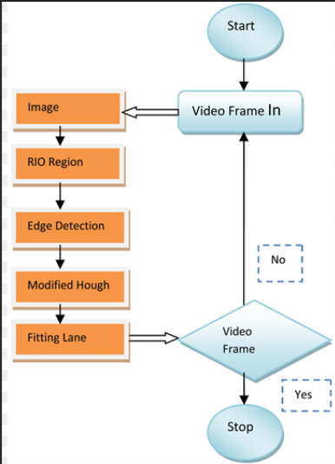
Architecture

Slide 7
Modules
Color Selection
Region Masking
Edge Detection Using Canny Edge detection method
Detecting lanes using Hough line transform

Slide 8
Color Selection
First let us select some colors. For Instance: Lane Lines are usually White in color and we know the RGB value of White is (255,255,255).
Here we will define a color threshold in the variables red_threshold, green_threshold, and blue_threshold and populate rgb_threshold with these values.
This vector contains the minimum values for red, green, and blue (R,G,B) that I will allow in my selection.

Slide 9
Region Masking
Let us assume that the front facing camera that took the image is mounted in a fixed position on the car, such that the lane lines will always appear in the same general region of the image.
Next, I'll take advantage of this by adding a criterion to only consider pixels for color selection in the region where we expect to find the lane lines.
I would like to retain for my color selection, while masking everything else out. Here I'm using a triangular mask to illustrate the simplest case, but we can use a quadrilateral, and in principle, we could use any polygon.

Slide 10
Edge Detection using Canny Edge detection
we are applying Canny to the gray-scaled image and our output will be another image called edges. low_threshold and high_threshold are your thresholds for edge detection.
the algorithm will first detect strong edge (strong gradient) pixels above the high_threshold, and reject pixels below the low_threshold.
Next, pixels with values between the low_threshold and high_threshold will be included as long as they are connected to strong edges.
The output edges is a binary image with white pixels tracing out the detected edges and black everywhere else.

Slide 11
Hough Transform and Detecting lanes
In image space, a line is plotted as x vs. Y
In Hough space, I can represent my "x vs. y" line as a point in "m vs. b" instead.
The Hough Transform is just the conversion from image space to Hough space.
So, the characterization of a line in image space will be a single point at the position (m, b) in Hough space.

Slide 12
Benefits of Lane Detection
Gives assistanceand details to pedestrians and drivers
Uniformity of the markings is an important factor in minimizing confusion and uncertainty about their meaning
Allows vehicular drivers to drive safely

Slide 13
THANK YOU
BY
SRINIVASAN E V 212221060261
ROHAN T 2122210228
KISHORE KUMAR R 212221060128
ECE Dept.

